Slide 1
AWS S3

Slide 2
What is Amazon S3?
Amazon S3 (Simple Storage Service) is an Object Storage
Many websites use Amazon S3 as a backbone
Many AWS services use Amazon S3 as an integration as well
We’ll have a step-by-step approach to S3

Slide 3
S3 Use case
• Backup and storage
• Disaster Recovery
• Archive
• Hybrid Cloud storage
• Application hosting
• Media hosting
• Data lakes & big data analytics
• Software delivery
• Static website

Slide 4
What is a Bucket?
Amazon S3 allows people to store objects (files) in “buckets” (directories)
• Buckets must have a globally unique name (across all regions all accounts)
• Buckets are defined at the region level
• S3 looks like a global service but buckets are created in a region
• Naming convention
• No uppercase, No underscore
• 3-63 characters long
• Not an IP
• Must start with lowercase letter or number
• Must NOT start with the prefix xn--
• Must NOT end with the suffix -s3alias

Slide 5
What is an Object?
Objects (files) have a Key
• The key is the FULL path:
s3://my-bucket/my_file.txt
s3://my-bucket/my_folder1/another_folder/my_file.txt
• The key is composed of prefix + object name
s3://my-bucket/my_folder1/another_folder/my_file.txt
• There’s no concept of “directories” within buckets
(although the UI will trick you to think otherwise)
• Just keys with very long names that contain slashes (“/”)

Slide 6
Objects
Object values are the content of the body:
• Max. Object Size is 5TB (5000GB)
• If uploading more than 5GB, must use “multi-part upload”
• Metadata (list of text key / value pairs – system or user metadata)
• Tags (Unicode key / value pair – up to 10) – useful for security / lifecycle
• Version ID (if versioning is enabled)

Slide 7
S3- Security
User-Based
• IAM Policies – which API calls should be allowed for a specific user from IAM
Resource-Based
• Bucket Policies – bucket wide rules from the S3 console - allows cross account
• Object Access Control List (ACL) – finer grain (can be disabled)
• Bucket Access Control List (ACL) – less common (can be disabled)
Note: an IAM principal can access an S3 object if
• The user IAM permissions ALLOW it OR the resource policy ALLOWS it
• AND there’s no explicit DENY
Encryption: encrypt objects in Amazon S3 using encryption keys

Slide 8
S3 Bucket Policy
JSON based policies
• Resources: buckets and objects
• Effect: Allow / Deny
• Actions: Set of API to Allow or Deny
• Principal: The account or user to apply the policy to
Use S3 bucket for policy to:
• Grant public access to the bucket
• Force objects to be encrypted at upload
• Grant access to another account (Cross Account)

Slide 9
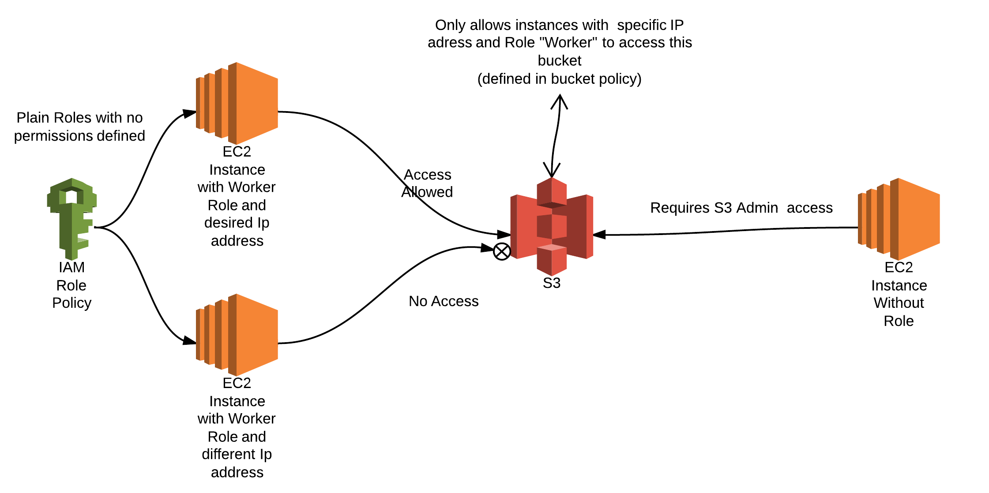

Slide 10
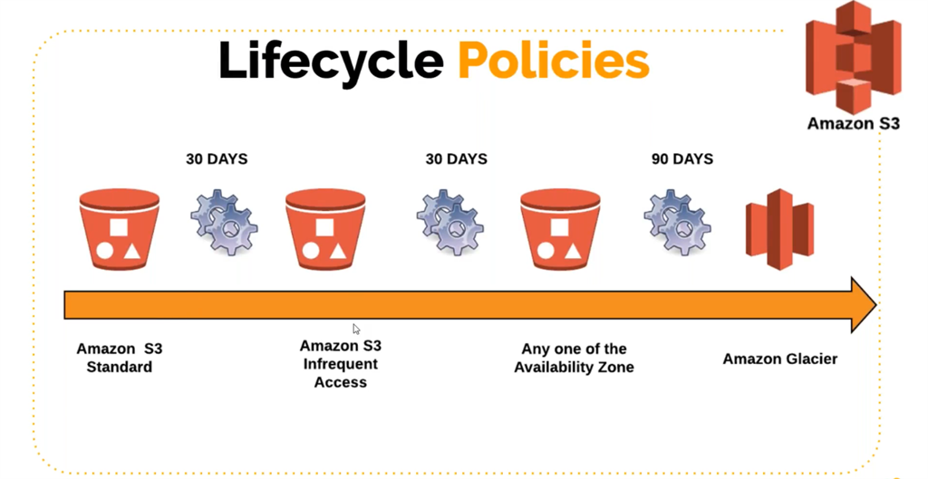

Slide 11
Bucket settings for Block Public Access
These settings were created to prevent company data leaks
• If you know your bucket should never be public, leave these on
• Can be set at the account level

Slide 12
Static Website Hosting
S3 can host static websites and have them accessible on the Internet
The website URL will be (depending on the region)
http://bucket-name.s3-website-aws-region.amazonaws.com
If you get a 403 Forbidden error, make sure the bucket policy allows public reads!

Slide 13
S3 Versioning
You can version your files in Amazon S3
• It is enabled at the bucket level
• Same key overwrite will change the “version”: 1, 2, 3….
• It is best practice to version your buckets
• Protect against unintended deletes (ability to restore a version)
• Easy roll back to previous version
• Any file that is not versioned prior to enabling versioning will have version “null”
• Suspending versioning does not delete the previous versions

Slide 14
S3 Replication
• Must enable Versioning in source and destination buckets
• Cross-Region Replication (CRR)
• Same-Region Replication (SRR)
• Buckets can be in different AWS accounts
• Copying is asynchronous
• Must give proper IAM permissions to S3
Use cases:
• CRR – compliance, lower latency access, replication across accounts
• SRR – log aggregation, live replication between production and test
accounts

Slide 15
After you enable Replication, only new objects are replicated
• Optionally, you can replicate existing objects using S3 Batch Replication
• Replicates existing objects and objects that failed replication
For DELETE operations
• Can replicate delete markers from source to target (optional setting)
• Deletions with a version ID are not replicated (to avoid malicious deletes)
There is no “chaining” of replication
• If bucket 1 has replication into bucket 2, which has replication into bucket 3
• Then objects created in bucket 1 are not replicated to bucket 3

Slide 16
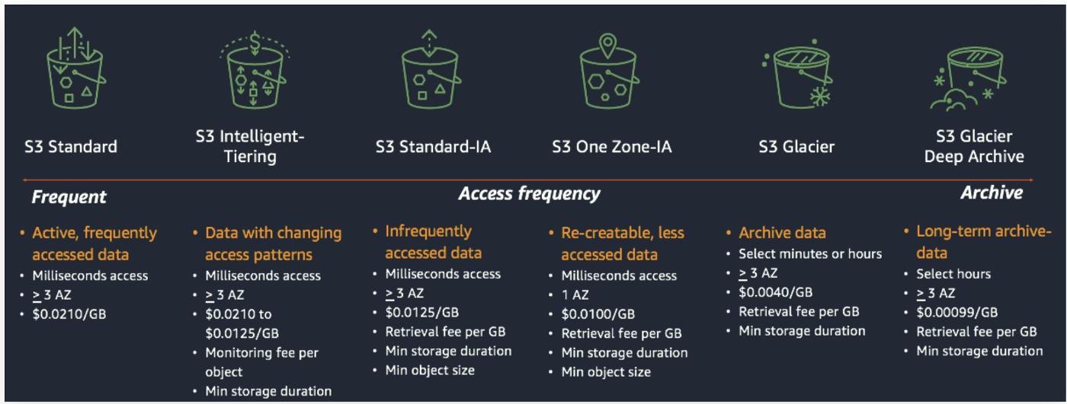
S3 Storage Class

Slide 17
S3 Storage Classes – Infrequent Access
• For data that is less frequently accessed, but requires rapid access when needed
• Lower cost than S3 Standard
• Amazon S3 Standard-Infrequent Access (S3 Standard-IA)
• 99.9% Availability
• Use cases: Disaster Recovery, backups
• Amazon S3 One Zone-Infrequent Access (S3 One Zone-IA)
• High durability (99.999999999%) in a single AZ; data lost when AZ is destroyed
• 99.5% Availability
• Use Cases: Storing secondary backup copies of on-premises data, or data you can recreate

Slide 18
S3 Glacier Storage Classes
Low-cost object storage meant for archiving / backup
• Pricing: price for storage + object retrieval cost
• Amazon S3 Glacier Instant Retrieval
• Millisecond retrieval, great for data accessed once a quarter
• Minimum storage duration of 90 days
• Amazon S3 Glacier Flexible Retrieval (formerly Amazon S3 Glacier):
• Expedited (1 to 5 minutes), Standard (3 to 5 hours), Bulk (5 to 12 hours) – free
• Minimum storage duration of 90 days
• Amazon S3 Glacier Deep Archive – for long term storage:
• Standard (12 hours), Bulk (48 hours)
• Minimum storage duration of 180 days

Slide 19
S3 Standard – General Purpose
• 99.99% Availability
• Used for frequently accessed data
• Low latency and high throughput
• Sustain 2 concurrent facility failures
• Use Cases: Big Data analytics, mobile & gaming applications, content
distribution…

Slide 20
S3 Intelligent-Tiering
Small monthly monitoring and auto-tiering fee
• Moves objects automatically between Access Tiers based on usage
• There are no retrieval charges in S3 Intelligent-Tiering
• Frequent Access tier (automatic): default tier
• Infrequent Access tier (automatic): objects not accessed for 30 days
• Archive Instant Access tier (automatic): objects not accessed for 90 days
• Archive Access tier (optional): configurable from 90 days to 700+ days
• Deep Archive Access tier (optional): config. from 180 days to 700+ days

Slide 21
Moving between Storage Classes
You can transition objects between storage classes
• For infrequently accessed object, move them to Standard IA
• For archive objects that you don’t need fast access to, move them to Glacier or Glacier Deep Archive
• Moving objects can be automated using a Lifecycle Rules

Slide 22
Lifecycle Rules
Transition Actions – configure objects to transition to another storage class
• Move objects to Standard IA class 60 days after creation
• Move to Glacier for archiving after 6 months
Expiration actions – configure objects to expire (delete) after some time
• Access log files can be set to delete after a 365 days
• Can be used to delete old versions of files (if versioning is enabled)
• Can be used to delete incomplete Multi-Part uploads
• Rules can be created for a certain prefix (example: s3://mybucket/mp3/*)
• Rules can be created for certain objects Tags (example: Department: Finance)

Slide 23
Ques) Your application on EC2 creates images thumbnails after profile photos
are uploaded to Amazon S3. These thumbnails can be easily recreated,
and only need to be kept for 60 days. The source images should be able
to be immediately retrieved for these 60 days, and afterwards, the user
can wait up to 6 hours. How would you design this?
• S3 source images can be on Standard, with a lifecycle configuration to
transition them to Glacier after 60 days
• S3 thumbnails can be on One-Zone IA, with a lifecycle configuration to
expire them (delete them) after 60 days

Slide 24
Ques) A rule in your company states that you should be able to recover your
deleted S3 objects immediately for 30 days, although this may happen
rarely. After this time, and for up to 365 days, deleted objects should be
recoverable within 48 hours.
• Enable S3 Versioning in order to have object versions, so that “deleted
objects” are in fact hidden by a “delete marker” and can be recovered
• Transition the “noncurrent versions” of the object to Standard IA
• Transition afterwards the “noncurrent versions” to Glacier Deep Archive

Slide 25
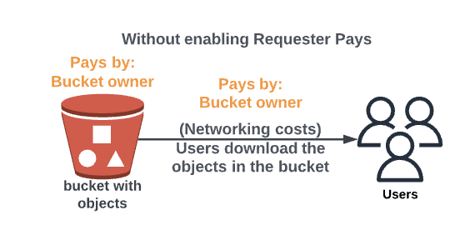
S3 Requester pays
In general, bucket owners pay for all Amazon S3 storage and data transfer costs associated with their bucket
• With Requester Pays buckets, the requester instead of the bucket owner pays the cost of the request and the data download from the bucket
• Helpful when you want to share large datasets with other accounts
• The requester must be authenticated in AWS (cannot be anonymous)

Slide 26
S3- Event Notification
S3:ObjectCreated, S3:ObjectRemoved,
S3:ObjectRestore, S3:Replication…
• Object name filtering possible (*.jpg)
• Use case: generate thumbnails of images uploaded to S3
• Can create as many “S3 events” as desired
• S3 event notifications typically deliver events in seconds but can sometimes take a minute or longer

Slide 27
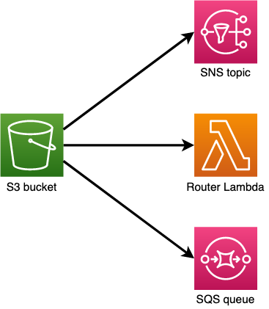
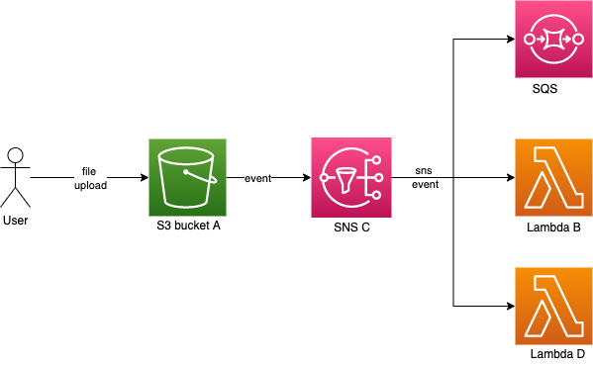

Slide 28
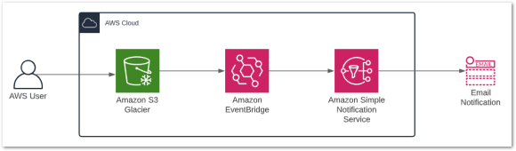
S3 Even Notifications with EventBridge
• Advanced filtering options with JSON rules (metadata, object size, name...)
• Multiple Destinations – ex- Lambda, Step Functions, Kinesis Streams / Firehose…
• EventBridge Capabilities – Archive, Replay Events, Reliable delivery

Slide 29
Amazon S3 automatically scales to high request rates, latency 100-200 ms
• Your application can achieve at least 3,500 PUT/COPY/POST/DELETE or
5,500 GET/HEAD requests per second per prefix in a bucket.
• There are no limits to the number of prefixes in a bucket.
Example (object path => prefix):
• bucket/folder1/sub1/file => /folder1/sub1/
• bucket/folder1/sub2/file => /folder1/sub2/
• bucket/1/file => /1/
• If you spread reads across all four prefixes evenly, you can achieve 22,000
requests per second for GET and HEAD

Slide 30
Batch operations
Perform bulk operations on existing S3 objects with a single request, example:
• Modify object metadata & properties
• Copy objects between S3 buckets
• Encrypt un-encrypted objects
• Modify ACLs, tags
• Restore objects from S3 Glacier
• Invoke Lambda function to perform custom action on each object
• A job consists of a list of objects, the action to perform, and optional parameters
• S3 Batch Operations manages retries, tracks progress, sends completion notifications, generate reports …
• You can use S3 Inventory to get object list and use S3 Select to filter your objects

Slide 31
Securing S3 resources

Slide 32
Object Encryption
You can encrypt objects in S3 buckets using one of 4 methods
Server-Side Encryption (SSE)
• Server-Side Encryption with Amazon S3-Managed Keys (SSE-S3) – Enabled by Default
Encrypts S3 objects using keys handled, managed, and owned by AWS
• Server-Side Encryption with KMS Keys stored in AWS KMS (SSE-KMS)
Leverage AWS Key Management Service (AWS KMS) to manage encryption keys
• Server-Side Encryption with Customer-Provided Keys (SSE-C)
When you want to manage your own encryption keys
• Client-Side Encryption

Slide 33
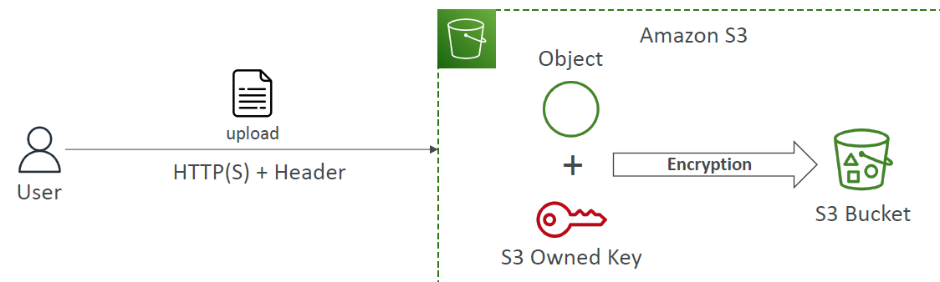
Encryption – SSE-S3
Encryption using keys handled, managed, and owned by AWS
• Object is encrypted server-side
• Encryption type is AES-256
• Must set header "x-amz-server-side-encryption": "AES256"
• Enabled by default for new buckets & new objects

Slide 34
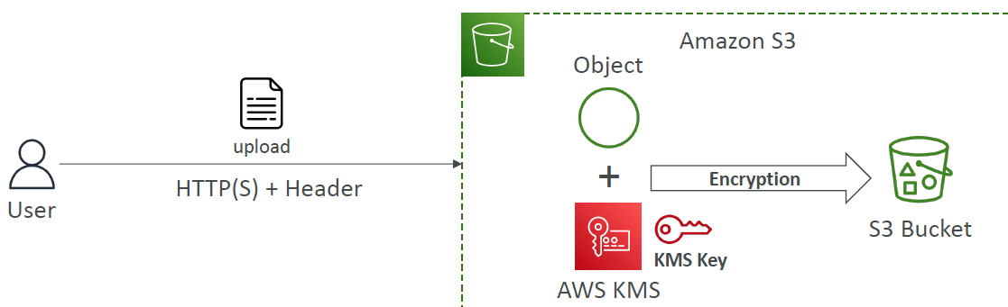
Encryption – SSE-KMS
Encryption using keys handled and managed by AWS KMS (Key Management Service)
• KMS advantages: user control + audit key usage using CloudTrail
• Object is encrypted server side
• Must set header "x-amz-server-side-encryption": "aws:kms"

Slide 35
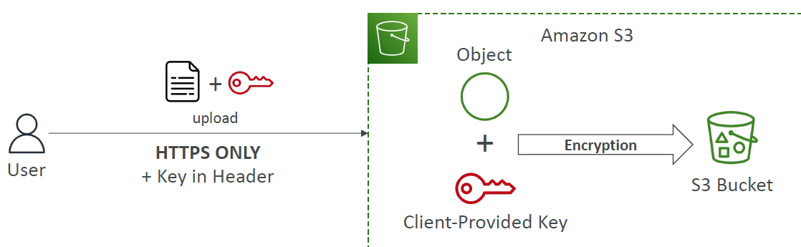
Encryption – SSE-C
Server-Side Encryption using keys fully managed by the customer outside of AWS
• Amazon S3 does NOT store the encryption key you provide
• HTTPS must be used
• Encryption key must provided in HTTP headers, for every HTTP request made

Slide 36
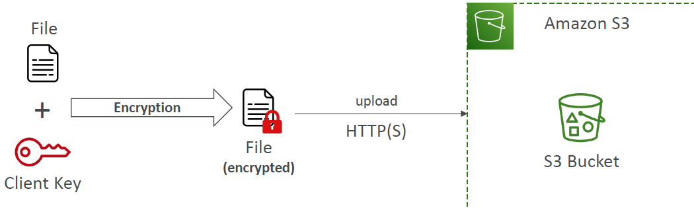
Client-side Encryption
• Use client libraries such as Amazon S3 Client-Side Encryption Library
• Clients must encrypt data themselves before sending to Amazon S3
• Clients must decrypt data themselves when retrieving from Amazon S3
• Customer fully manages the keys and encryption cycle

Slide 37
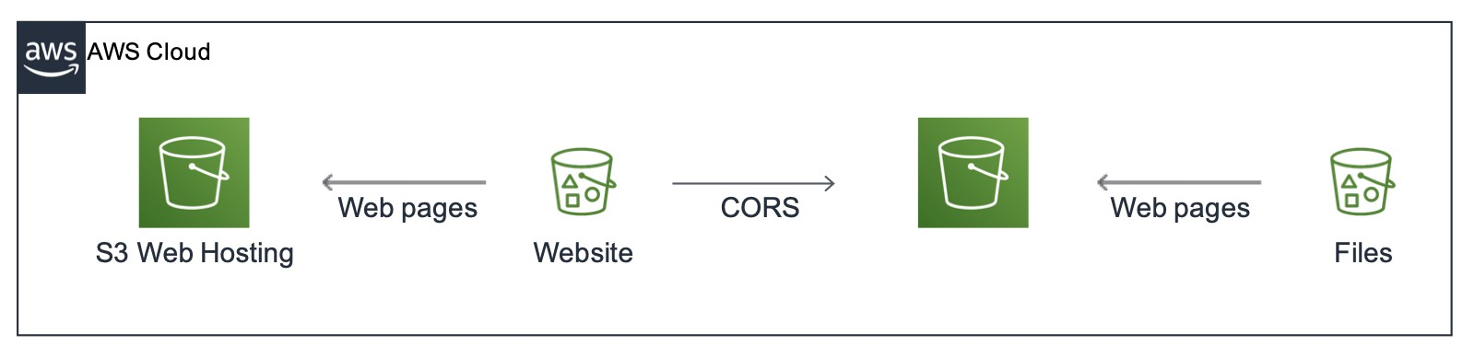
What is CORS?
Cross-Origin Resource Sharing (CORS)
• Origin = scheme (protocol) + host (domain) + port
example: https://www.example.com (implied port is 443 for HTTPS, 80 for HTTP)
• Web Browser based mechanism to allow requests to other origins while visiting the main origin
• Same origin: http://example.com/app1 & http://example.com/app2
• Different origins: http://www.example.com & http://other.example.com
• The requests won’t be fulfilled unless the other origin allows for the
requests, using CORS Headers (example: Access-Control-Allow-Origin)
• If a client makes a cross-origin request on our S3 bucket, we need to enable
the correct CORS headers. It’s a popular exam question
• You can allow for a specific origin or for * (all origins)

Slide 38
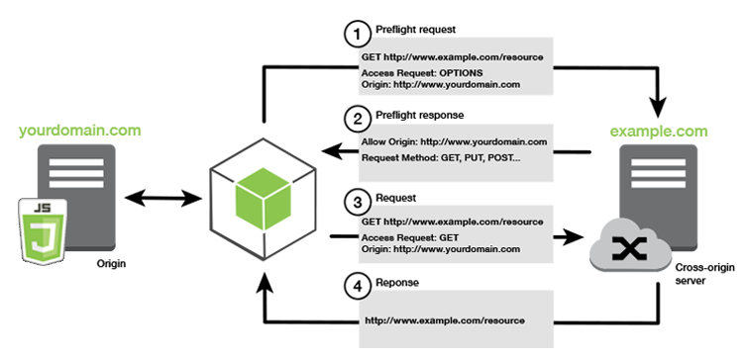

Slide 39
MFA Delete
MFA (Multi-Factor Authentication) – force users to generate a code on a
device (usually a mobile phone or hardware) before doing important
operations on S3
• MFA will be required to:
• Permanently delete an object version
• Suspend Versioning on the bucket
• MFA won’t be required to:
• Enable Versioning
• List deleted versions
• To use MFA Delete, Versioning must be enabled on the bucket
• Only the bucket owner (root account) can enable/disable MFA Delete

Slide 40
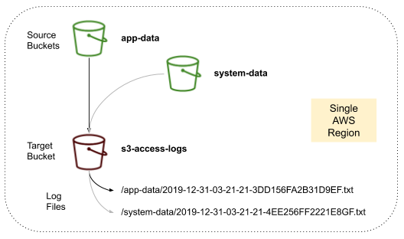
Access Logs
• For audit purpose, you may want to log all access to S3 buckets
• Any request made to S3, from any account, authorized or denied,
will be logged into another S3 bucket
• That data can be analyzed using data analysis tools…
• The target logging bucket must be in the same AWS region
Do not set your logging bucket to be the monitored bucket
• It will create a logging loop, and your bucket will grow exponentially

Slide 41
Pre-Signed URLs
Generate pre-signed URLs using the S3 Console, AWS CLI or SDK
• URL Expiration
• S3 Console – 1 min up to 720 mins (12 hours)
• AWS CLI – configure expiration with --expires-in parameter in seconds
(default 3600 secs, max. 604800 secs ~ 168 hours)
• Users given a pre-signed URL inherit the permissions of the user that generated the URL for GET / PUT
• Examples:
• Allow only logged-in users to download a premium video from your S3 bucket
• Allow an ever-changing list of users to download files by generating URLs dynamically
• Allow temporarily a user to upload a file to a precise location in your S3 bucket

Slide 42
Glacier Vault Lock
Adopt a WORM (Write Once Read Many) model
• Create a Vault Lock Policy
• Lock the policy for future edits (can no longer be changed or deleted)
• Helpful for compliance and data retention

Slide 43
Object Lock (versioning must be enabled)
Adopt a WORM (Write Once Read Many) model
• Block an object version deletion for a specified amount of time
Retention mode - Compliance:
• Object versions can't be overwritten or deleted by any user, including the root user
• Objects retention modes can't be changed, and retention periods can't be shortened
Retention mode - Governance:
• Most users can't overwrite or delete an object version or alter its lock settings
• Some users have special permissions to change the retention or delete the object
Retention Period: protect the object for a fixed period, it can be extended
Legal Hold:
• protect the object indefinitely, independent from retention period
• can be freely placed and removed using the s3:PutObjectLegalHold IAM permission

Slide 44
Access Points
Access Points simplify security management for S3 Buckets
• Each Access Point has:
• its own DNS name (Internet Origin or VPC Origin)
• an access point policy (similar to bucket policy) – manage security at scale
We can define the access point to be accessible only from within the VPC
• You must create a VPC Endpoint to access the Access Point (Gateway or Interface Endpoint)
• The VPC Endpoint Policy must allow access to the target bucket and Access Point

Slide 45
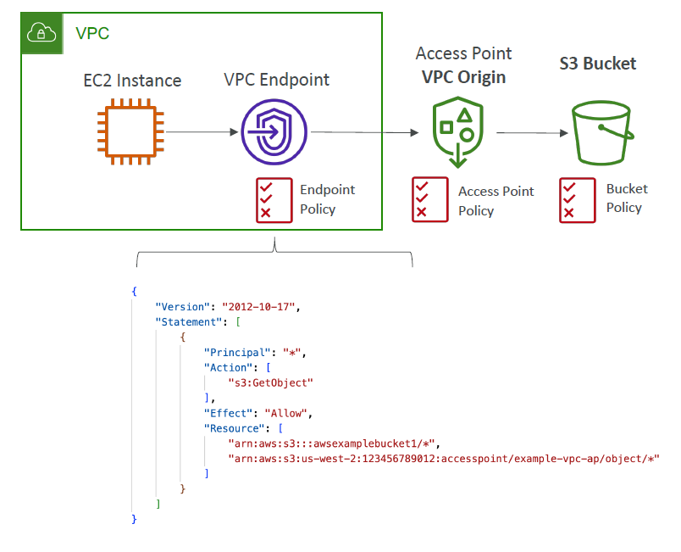

Slide 46
Object Lambda
Use AWS Lambda Functions to change the object before it is retrieved by the caller application
• Only one S3 bucket is needed, on top of which we create S3 Access Point and S3 Object Lambda Access Points.
• Use Cases:
• Redacting personally identifiable information for analytics or nonproduction environments.
• Converting across data formats, such as converting XML to JSON.
• Resizing and watermarking images on the fly using caller-specific details, such as the user who requested the object.

Slide 47
